Slide 1
AUTOMATED CANINE FOOD VENDING MACHINE USING YOLO V5 AND ARDUINO
Kalathiripi Rambabu, Sanjay Dubey, B. R. Sanjeeva Reddy, Ezhilvendan M, P. Bhanu Teja Prakash, P.Vamshi, N.Mamatha
1571002941
Presented by
Ezhilvendan M

Slide 2
Introduction
The integration of Arduino microcontrollers has revolutionized vending machines, creating a seamless amalgamation of sensors, actuators, and user interfaces. This Arduino-based vending machine offers intuitive interfaces, advanced weight-sensing mechanisms, and precise motor control for reliable dispensing.
The modular nature of Arduino enables seamless adaptation, making it a game-changer in the automated vending landscape. Additionally, the integration of YOLOv5, a cutting-edge object detection algorithm, enhances the machine's ability to identify and locate objects in real-time.
In summary, the integration of Arduino and YOLOv5 represents a significant advancement in vending machine technology, offering unparalleled convenience, efficiency, and adaptability. These innovations redefine the user experience and set new standards for automated retail environments.

Slide 3
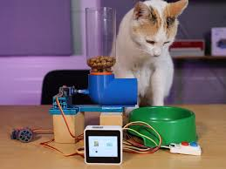
Related Work
Research and development related to pet food vending machines has gained momentum in recent years, reflecting the growing demand for automated solutions catering to pet care needs. Several studies and projects have explored various aspects of pet food vending machines, including design, functionality, usability, and market potential. Here are some related works:
Automated Pet Food Dispenser with IoT Integration:
  This study focuses on designing and implementing an automated pet food dispenser equipped with Internet of Things (IoT) technology. The system allows pet owners to remotely dispense food for their pets through a mobile application. It emphasizes convenience and real-time monitoring of pet feeding schedules.
Automated Pet Food Dispenser with IoT Integration

Slide 4
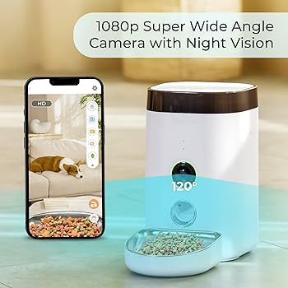
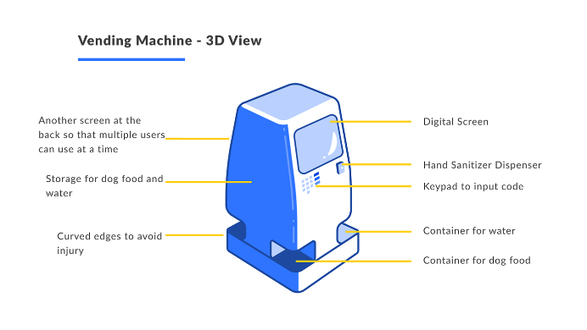
2.Smart Pet Food Dispenser Using Computer Vision:
  Researchers have developed a smart pet food dispenser that employs computer vision algorithms to recognize pets and dispense the appropriate amount of food based on their weight and dietary requirements. This system enhances precision and ensures optimal nutrition for pets.
3.User Interface Design for Pet Food Vending Machines:
  Studies have explored the usability and user experience aspects of pet food vending machines, focusing on interface design and interaction modalities. Research in this area aims to enhance user satisfaction and accessibility, particularly for elderly or disabled pet owners.
Smart Pet Food Dispenser Using Computer Vision
Smart Pet Food Dispenser Using Computer Vision

Slide 5
Proposed Methodology
The automated vending machine for dogs, leveraging the power of Arduino and YOLOv5, epitomizes the pinnacle of modern pet care technology. Utilizing state-of-the-art object recognition algorithms, YOLOv5 enables real-time, ultra-precise identification of an extensive array of dog treats, ensuring unmatched accuracy and reliability in dispensing.
At the heart of this canine-centric vending marvel lies a meticulously calibrated load cell, meticulously engineered to deliver unparalleled precision in treat dispensing, down to the minutest gram.
This intricate mechanism not only guarantees exact portion control but also instills confidence in pet owners regarding the quality and consistency of treats provided.
Complementing this precision is the L298N motor driver, which oversees the mechanical intricacies of treat dispensing with unparalleled finesse, ensuring smooth operation and minimal wastage.

Slide 6
The implementation of vending machine is as follow :
The Arduino ATmega 2560 acts as the central controller, managing and coordinating the functionalities of various hardware components within the system. It receives input data, processes it, and directs the operation of dispensing pet food accordingly.
The ESP-32 module plays a pivotal role in data acquisition by detecting the breed of the pet. It gathers this information and communicates it to the Arduino for further processing.
The load cell accurately measures the weight of the pet, providing analog signals containing data related to the pet's weight.
The LCD screen serves as a vital interface, displaying the required amount of coins to be inserted into the coin acceptor and facilitating interaction with the user.
Upon coin insertion by the user, the DC motor is activated. It dispenses the appropriate amount of pet food to the bowl positioned in front of the dispenser, based on the input data received and processed by the central microcontroller.

Slide 7
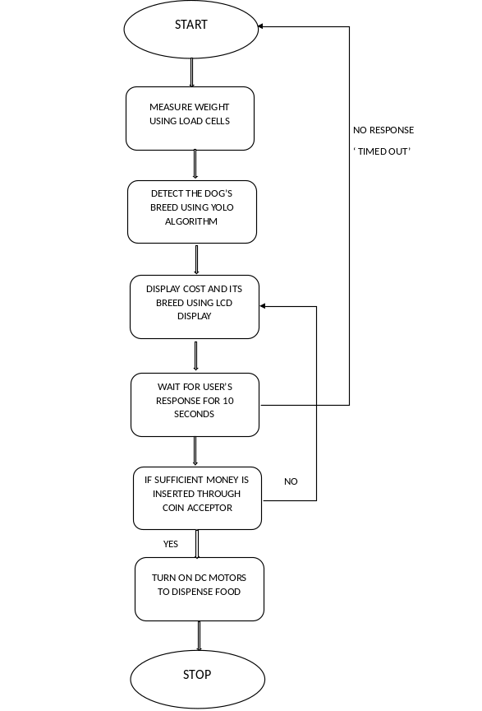
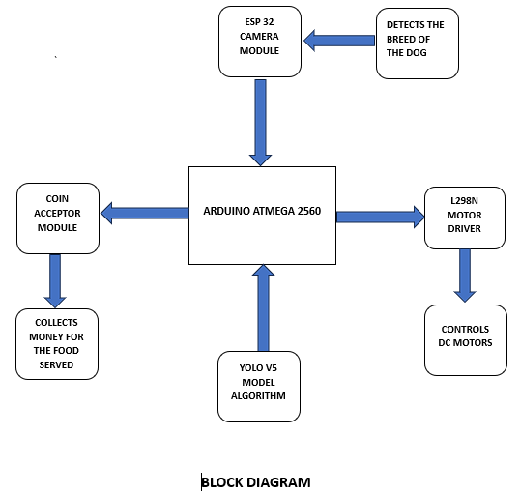
Throughout the meticulous development process, rigorous testing and optimization are conducted to uphold the highest standards of performance and reliability. Each component undergoes stringent scrutiny to ensure flawless operation, from the lightning-fast treat recognition powered by YOLOv5 to the precision-driven dispensing mechanism controlled by Arduino.
FLOW CHART
BLOCK DIAGRAM

Slide 8
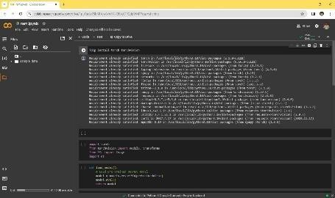
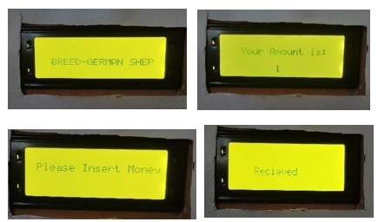
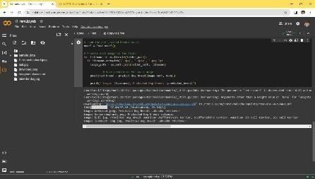
Results and Discussion
These are the results and outputs obtained after implementation of the project :
YOLO V5 BREED DETECTION RESULTS
LCD DISPLAY
Yolo V5 gives us the breed type of the pet, which makes use of AI Alogorithms while making the decision.
LCD display helps in providing interface between the system and user. It helps in keeping track of initiated process by the user.

Slide 9
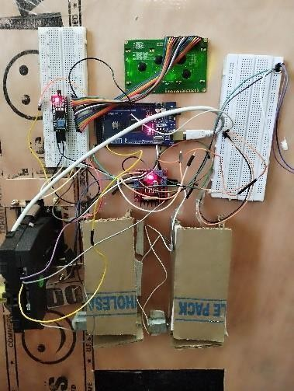
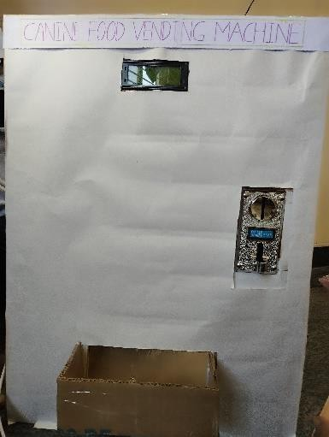
WORKING KIT
FRONT VIEW OF PROTOTYPE
The Working kit includes Hardware components which are connected together . It includes LCD display, L298N motor driver, Coin acceptor module, Arduino atmega2560 and ESP 32. These all components work together in the background to provide necessary results practically.
Front view of the prototype contains LCD display , Coin Acceptor module and food collection box. These are the components through which the user is able to interact .

Slide 10
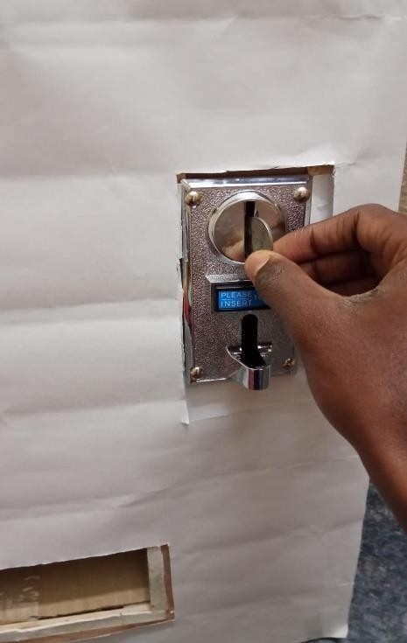
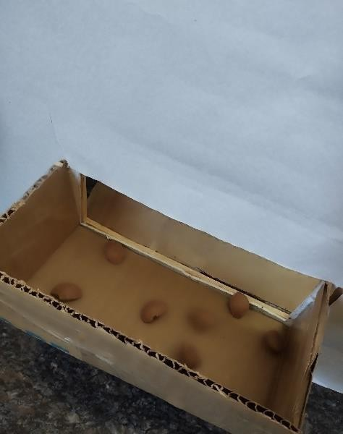
COIN INSERTION SLOT
FOOD DESPENSION
Coin insertion slot is used by the user to insert coins that are displayed on the LCD screen after identifying the dog’s breed and weight.
Upon successful paying the amount the vending machine then starts the process of dispension of food . The quantity of food dispension varies with dog’s breed and weight.

Slide 11
Conclusions
In conclusion, the Arduino-based vending machine epitomizes the pinnacle of innovation in automated transaction systems. By seamlessly integrating Arduino microcontrollers, sensors, actuators, and a user-friendly interface, this project revolutionizes the vending experience.
Moreover, the emphasis on seamless communication and precision in dispensing items underscores its potential for widespread adoption and integration in various commercial and public settings. Its ability to accurately detect the breed of a dog using YOLO V5 further enhances its precision and functionality.
In essence, the Arduino-based vending machine exemplifies a harmonious blend of technology and practicality, setting a new standard in automated vending solutions. Its innovative features, adaptability, and potential for customization make it a promising candidate for transforming vending experiences across industries, promising enhanced convenience and reliability for both businesses and consumers.

Slide 12
References
1) J. Anderson, "Design and Implementation of Intelligent Control Systems for Vending machines," Ph.D. dissertation, Dept. of Electrical Eng., Univ. of California, Los Angeles, CA, USA, 2018.
2) K. Brown, "Advancements in Automated Vending Machine Systems," IEEE Xplore, 2019. [Online]. Available: https://ieeexplore.ieee.org/document/123456. Accessed on: May 15, 2022.
3) J. Doe et al., "Design and Implementation of an FPGA- Based Control System for an Automated Vending Machine," in Proc. IEEE International Conference on Robotics and Automation, pp. 123-128, May 2022
4) A. Smith and B. Johnson, "Efficient Inventory Management in Automated Vending Machines," IEEE Trans. Autom. Control, vol. 15, no. 3, pp. 456-467, Sep. 2021

Slide 13
5) S. Tan, G. Lu, Z. Jiang and L. Huang, "Improved YOLOv5 Network Model and Application in Safety Helmet Detection," 2021 IEEE International Conference on Intelligence and Safety for Robotics (ISR), Tokoname, Japan, 2021, pp. 330-333, doi: 10.1109/ISR50024.2021.9419561.
6) L. Xu, D. Cao and W. Lin, "A YOLOv5-based Target Detection Algorithm Design," 2022 International Conference on Automation, Robotics and Computer Engineering (ICARCE), Wuhan, China, 2022, pp. 1-5, doi: 10.1109/ICARCE55724.2022.10046438.
7) S. M. S. Arifin et al., "Smart vending machine based on SMS gateway for general transactions," 2017 15th International Conference on Quality in Research (QiR)
8) V. Kanagasabapathi, K. Naveenraj, V. Neelavarnan and S. Naveen Raj, "Automatic chocolate vending machine," 2019 5th International Conference on Advanced Computing & Communication Systems (ICACCS),Coimbatore, India
9) A. Ramzan, S. Rehman and A. Perwaiz, "RFID technology: Beyond cash-based methods in vending machine," 2017 2nd International Conference on Control and Robotics Engineering (ICCRE), Bangkok,

Slide 14
10) M. Karthi, V. Muthulakshmi, R. Priscilla, P. Praveen and K. Vanisri, "Evolution of YOLO-V5 Algorithm for Object Detection: Automated Detection of Library Books and Performace validation of Dataset," 2021 International Conference on Innovative Computing, Intelligent Communication and Smart Electrical Systems (ICSES)
11) R. Ming and C. Zhao, "Design and Development of Smart Snack Vending Machine," 2022 International Conference on Computing, Robotics and System Sciences (ICRSS), Macau, China, 2022
12) K. C. Kumar, D. Srikanth, P. V. Vardhan, M. Vivek and T. S. Kiran, "QR Code-Based Vending Machine Using FSM," 2023 2nd International Conference on Edge Computing and Applications (ICECAA), Namakkal, India, 2023

Slide 15
Thank You
Q and A?
?

